Slide 1



Classification of Iris Dataset Using Decision Tree
Project - Digital Skill Fair 33.0 – Dibimbing
by : Maulidya Nur Shafira

Slide 2
Iris Dataset Overview
The Iris dataset can be used as a starter dataset to understand classification algorithms in machine learning. Using the features of the iris flowers, researchers can classify each sample into one of three species.
The Iris dataset comprises 150 samples of iris flowers from three distinct species: Setosa, Versicolor, and Virginica.
Each sample is characterised by four features: sepal length, sepal width, petal length, and petal width.
The target variable represents the species of the iris flowers and has three classes: Iris Setosa, Iris Versicolor, and Iris Virginica.

Slide 3
Decision Tree Overview
Decision Tree is a supervised learning technique that can be used for both classification and regression problems.
That uses a tree-like structure to classify data into different classes.
The Decision Tree is easy to understand and visualise. This makes it useful for decision making.
Features of Decision Tree: tree-like structure, simple to understand and interpret, versatility, feature importance.

Slide 4
The Process for Iris Data Classification
01.
02.
03.
Import Library
Load Dataset
Exploratory Data Analysis
06.
05.
04.
Model Evaluation
Machine Learning Model
(Decision Tree – Supervised Learning)
Split Data
07.
Visualization of Decision Tree

Slide 5
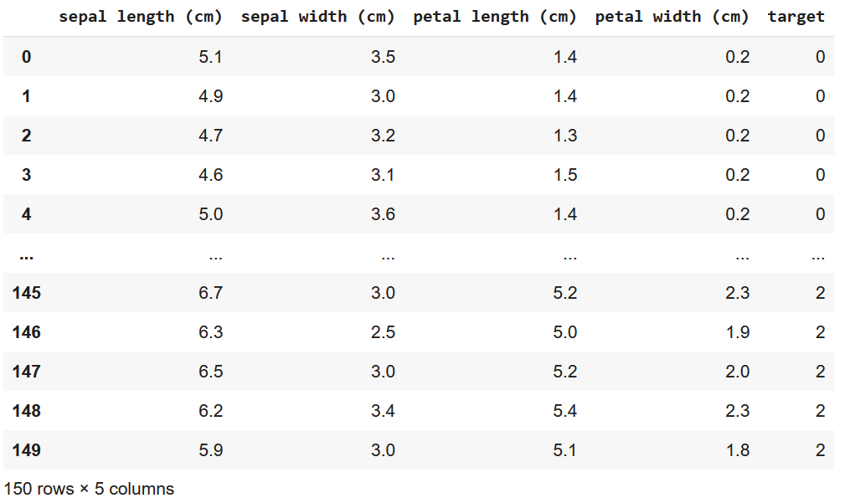
The Iris Dataset

Slide 6
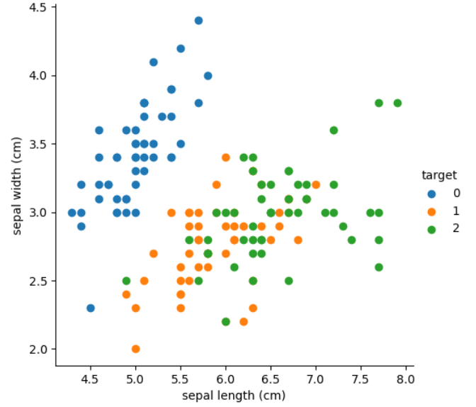
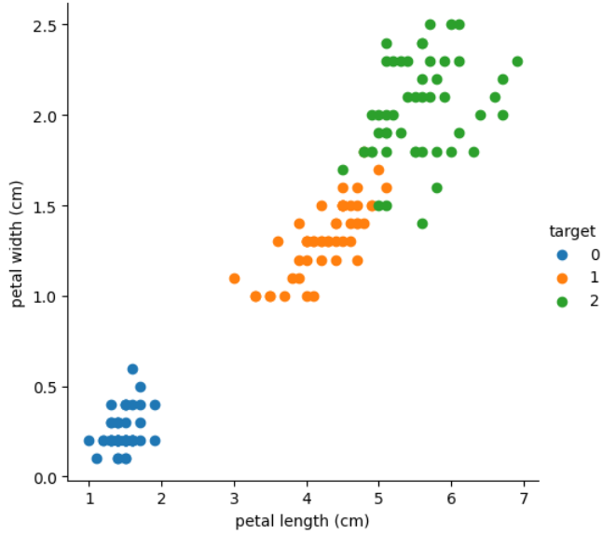
Scatter plot of iris flowers from three different species based on sepal width and sepal length features
Scatter plot of iris flowers from three different species based on petal width and petal length features
Species/Target
0 = Setosa
1 = Versicolor
2 = Virginica

Slide 7
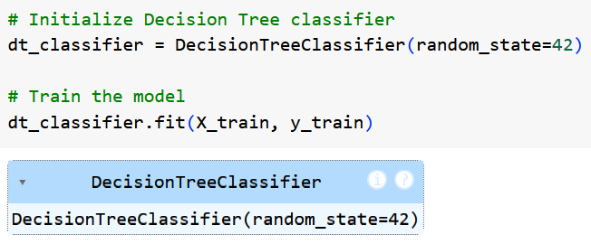
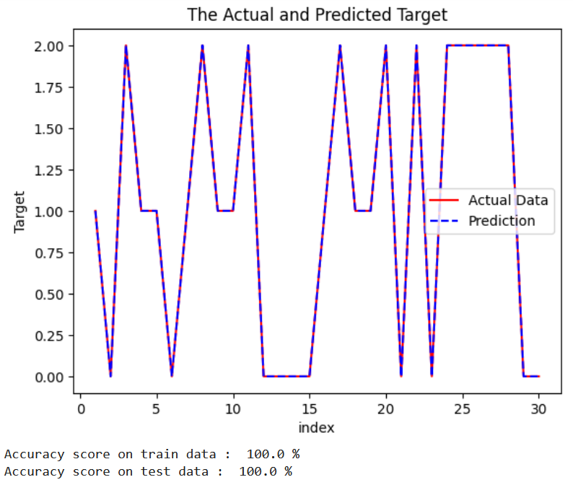
Machine Learning Model Decision Tree - Supervised Learning
Model Evaluation

Slide 8
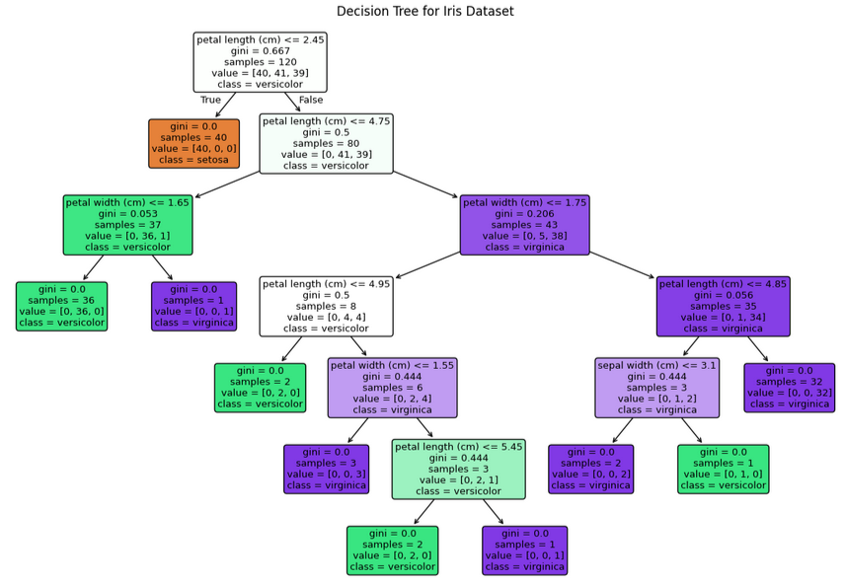

Slide 9
Conclusion
01
02
03
The iris dataset is of significant importance within the field of machine learning, largely due to its simplicity.
The Decision Tree is capable of accurately predicting the classification of iris flowers with 100% accuracy.
Decision Tree algorithm is applicable to classification tasks. The model decisions and their potential outcomes as tree.

Slide 10


THANK YOU!
www.linkedin.com/in/maulidya-nur-shafira
maulidia.jbr18@gmail.com

